Slide 1


Vision – Visualization
Communication Report
Tong Li
ZJUTVIS Lab
Zhejiang University of Technology

Slide 2
Outline
Video Vis
Pros. and Cons.
Related Work
OD Vis
ER Vis
HPE Vis
Our Work
Background and Challenge
Hierarchical Task Analysis
Workflow
Case Demonstration
Discussion

Slide 3
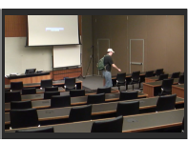


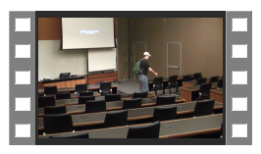
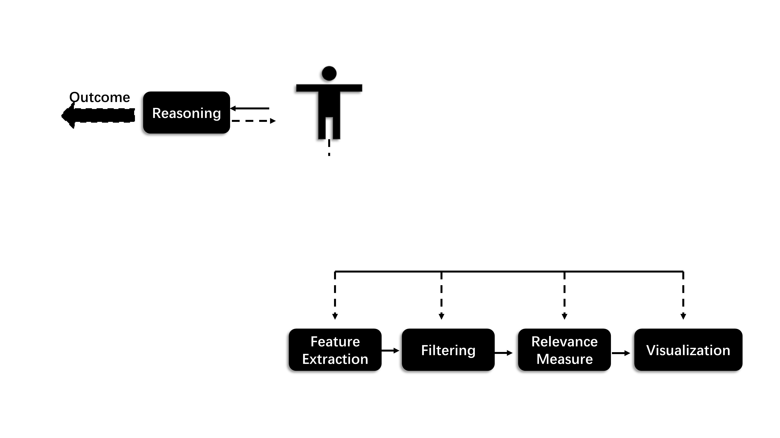
Pros. and Cons.
Performance: Strong Computational and Comprehension Skills
× Manual Inspection: Labor-intensive Tasks
× Machine Intelligence: Inaccurate Results
Visibility: Improve the visibility of video content.
Interpretability: Improve the interpretability of video semantic understanding models.
ML & AI
User Intent
Expert Intent
Reasoning
Visual Analysis

Slide 4
Outline
Video Vis
Pros. and Cons.
Related Work
OD Vis
ER Vis
HPE Vis
Our Work
Background and Challenge
Hierarchical Task Analysis
Workflow
Case Demonstration
Discussion

Slide 5
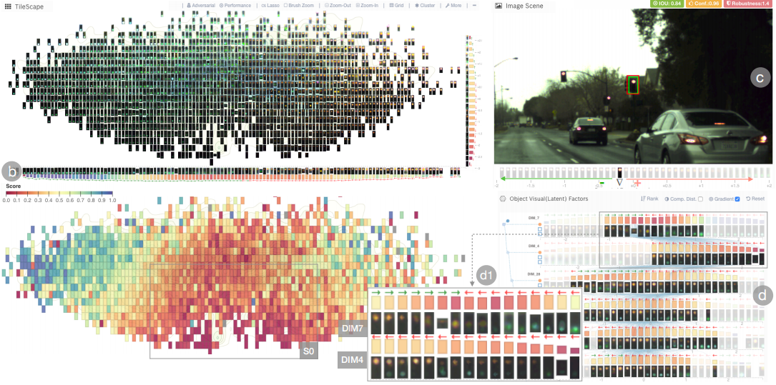
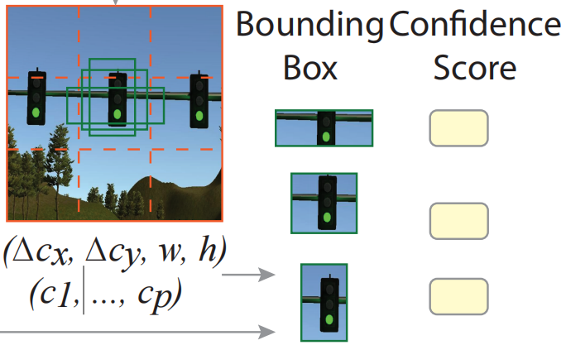
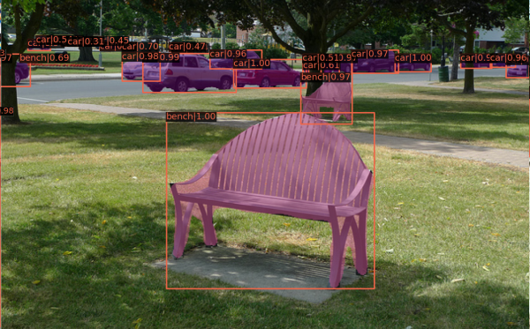
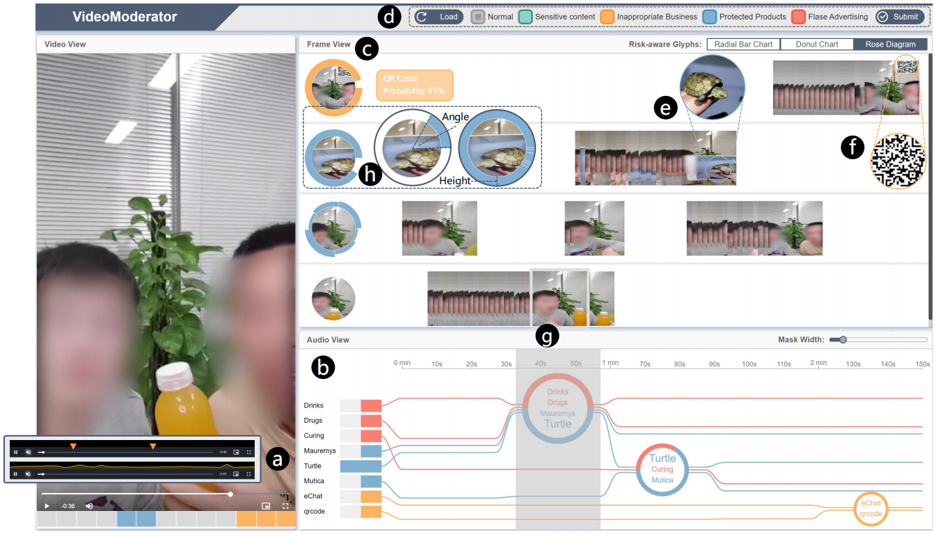
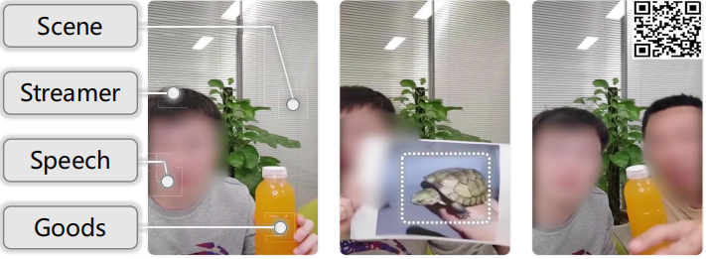
Object Detection / Semantic Segmentation VIS
TVCG, 2020 ^{[1]}
Scene
Certain Objects
TVCG, 2021 ^{[2]}

Slide 6
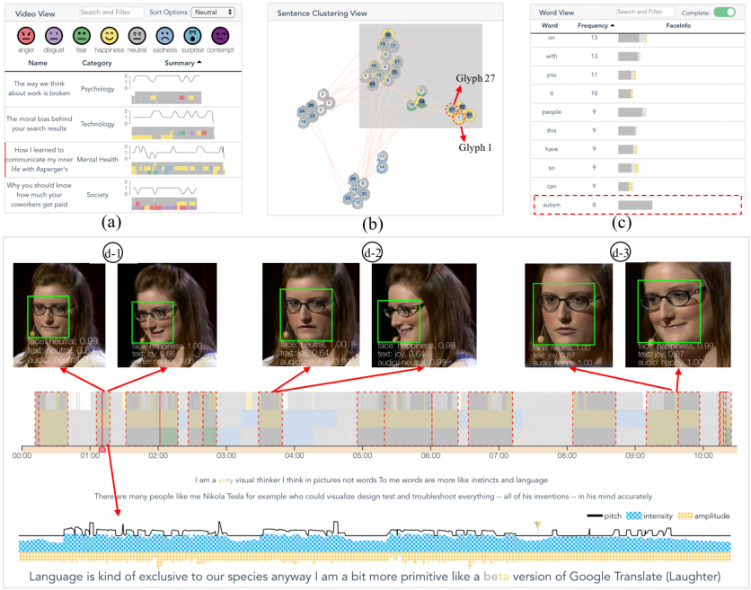
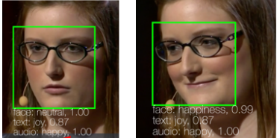
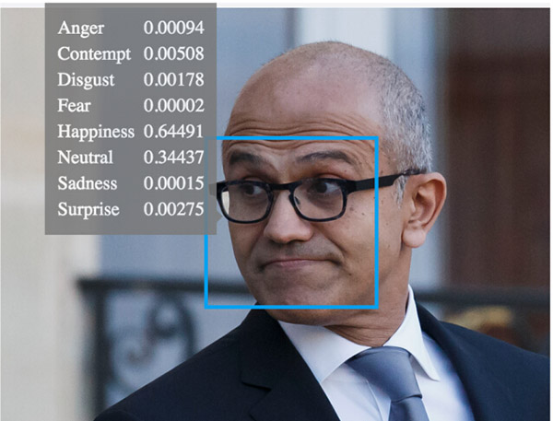
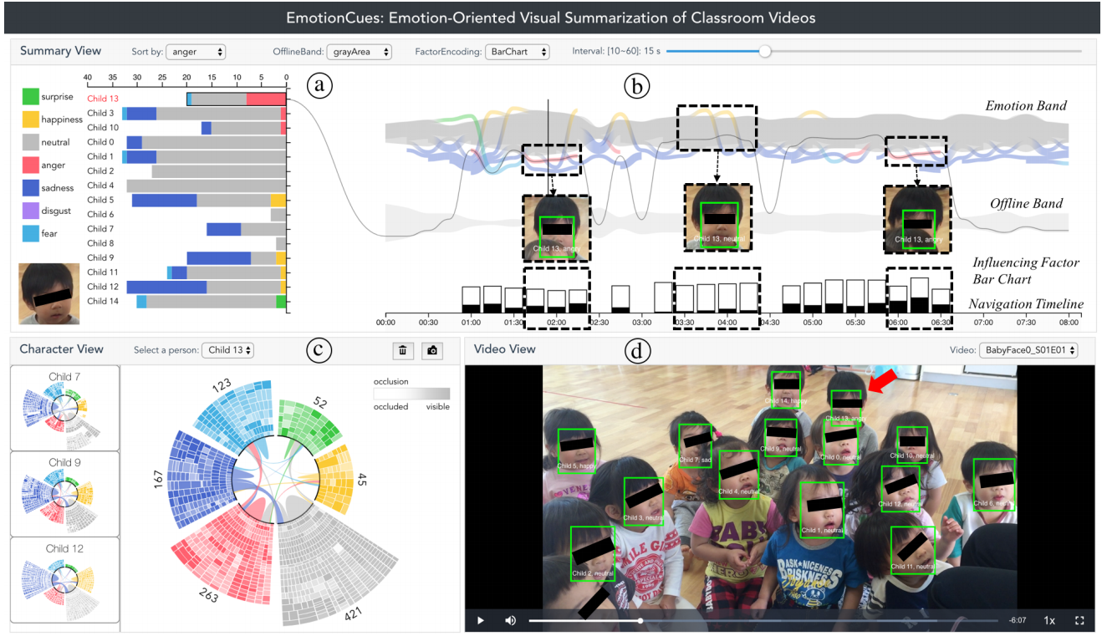
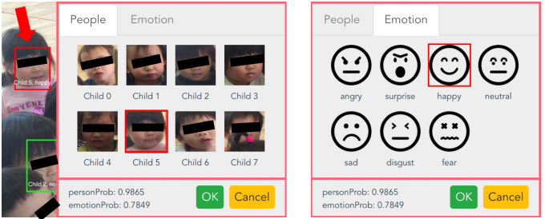
Emotion Recognition VIS
TVCG, 2019 ^{[3]}
Human Face
Clear Shot
TVCG, 2020 ^{[4]}

Slide 7
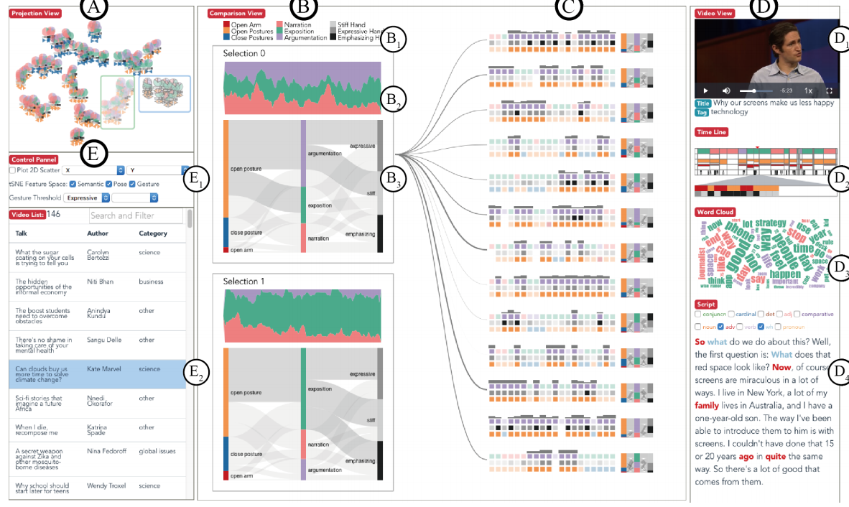
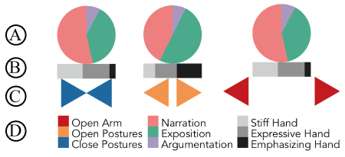
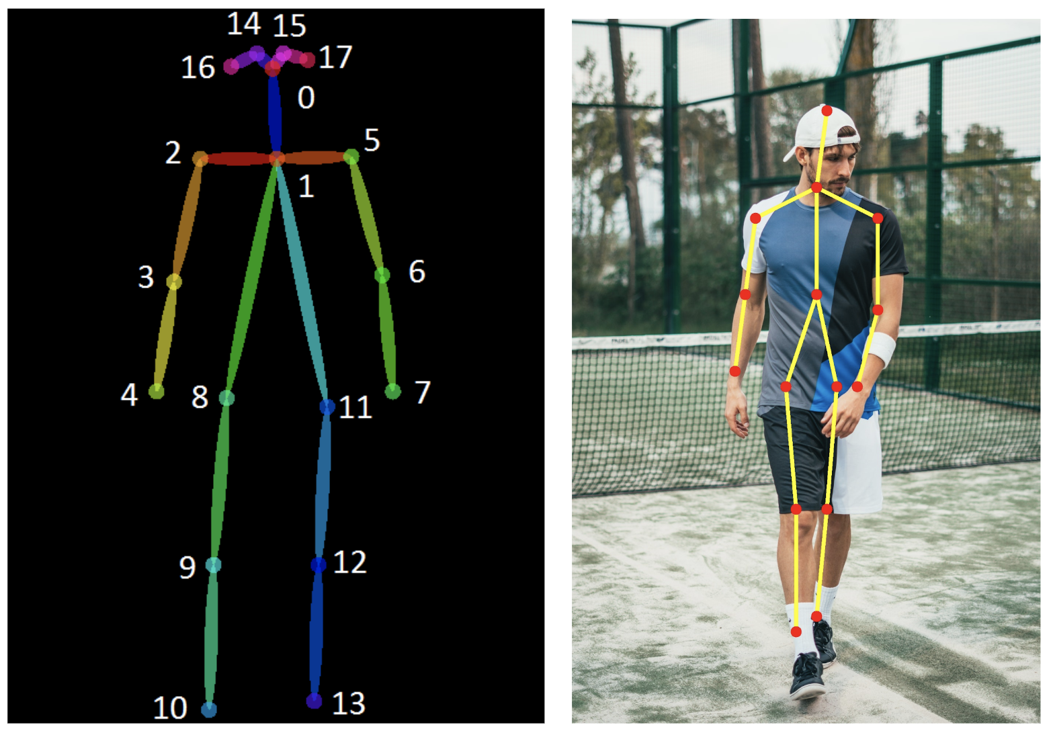
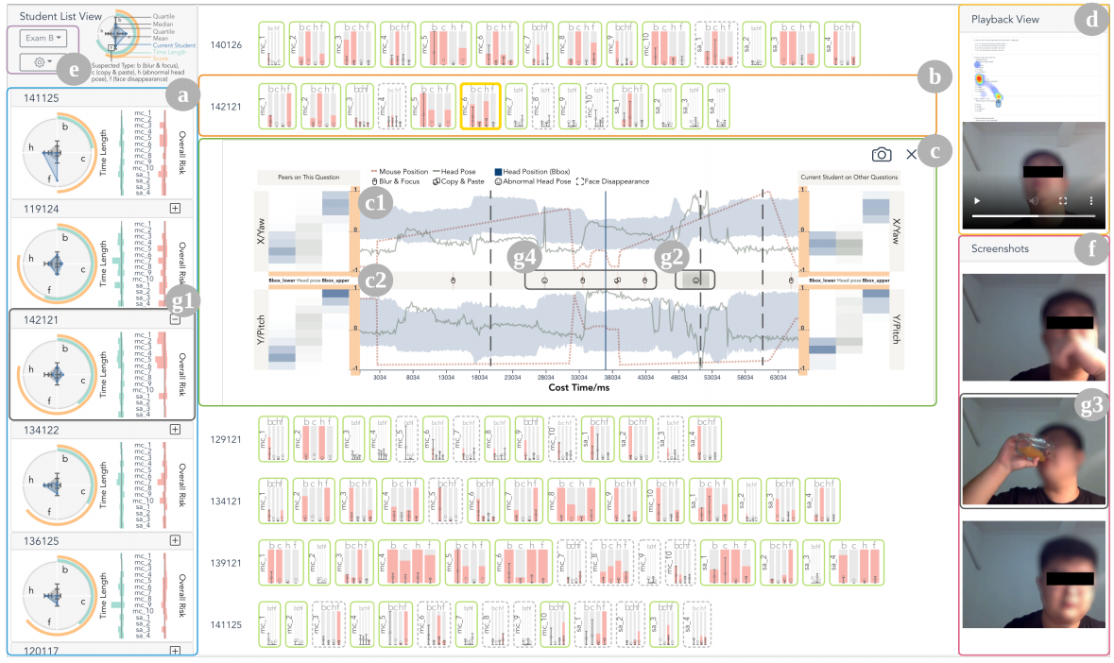
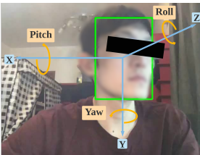
Human Pose Estimation VIS
TCVG, 2018 ^{[5]}
Skeleton, Keypoints, Pose
Body Expression
CHI, 2021 ^{[6]}

Slide 8
Outline
Video Vis
Pros. and Cons.
Related Work
OD Vis
ER Vis
HPE Vis
Our Work
Background and Challenge
Hierarchical Task Analysis
Workflow
Demo
Case Demonstration
Discussion

Slide 9
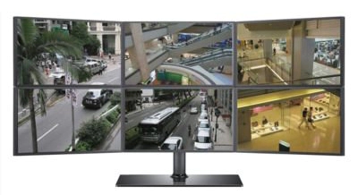
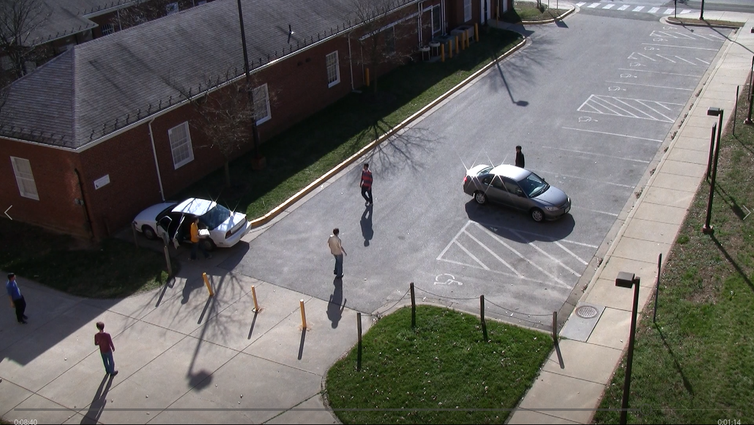




Surveillance Video
Data Challenge
Big Data、Uneven Quality
Noise Data
Loose Structures or Without Story Units
Analytics Goal
Reduce the time of reviewing videos.
Understand video with low cost.
Multi-feature
Time Series
Visual Analysis
SurVizor

Slide 10
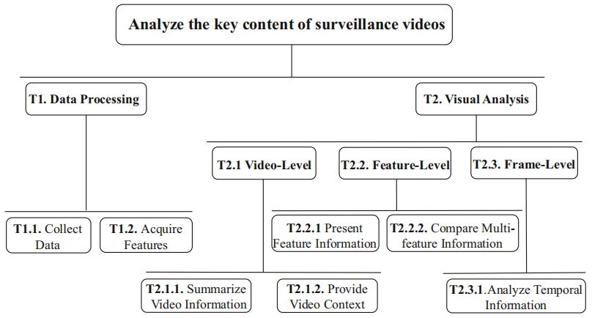
SurVizor: Hierarchical Task Analysis
T1. Data Processing
T1.1. Collect Data
T1.2. Acquire Features
T2. Visual Analysis
T2.1. Video-Level
T2.2. Feature-Level
T2.3. Frame-Level
Guodao Sun, Tong Li, and Ronghua Liang. "SurVizor: visualizing and understanding the key content of surveillance videos." Journal of Visualization. 2021.

Slide 11
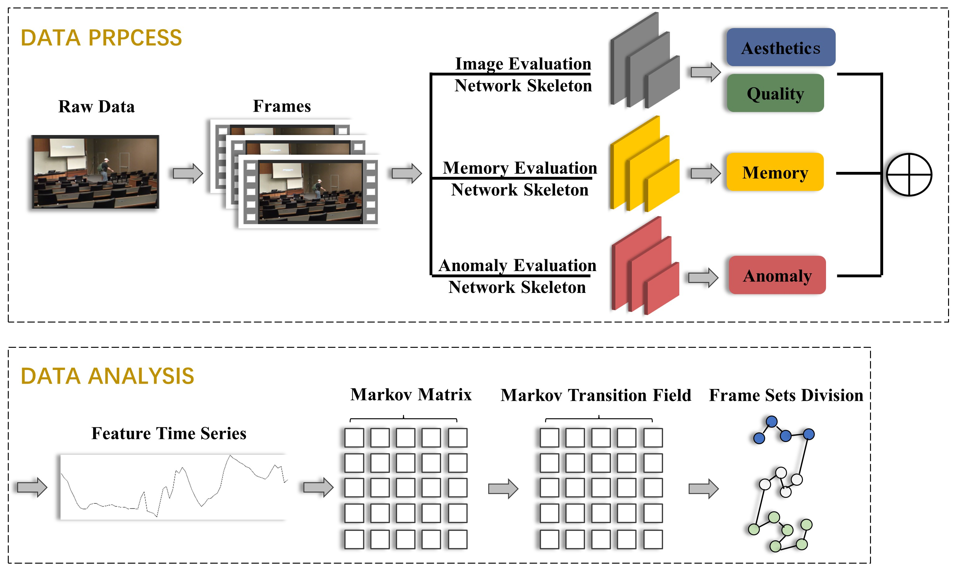
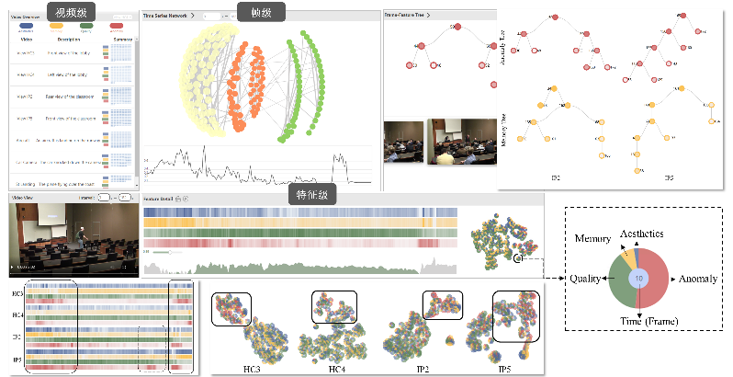
SurVizor: Workflow
VISUAL ANALYSIS
Guodao Sun, Tong Li, and Ronghua Liang. "SurVizor: visualizing and understanding the key content of surveillance videos." Journal of Visualization. 2021.

Slide 12
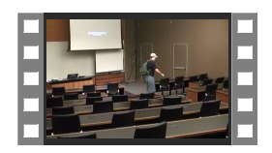
SurVizor: Case Demonstration
Location: Campus - Classroom
Duration: 5mins
Guodao Sun, Tong Li, and Ronghua Liang. "SurVizor: visualizing and understanding the key content of surveillance videos." Journal of Visualization. 2021.

Slide 13

SurVizor: Discussion
Feature Selection
Dynamic Sampling
f_{iAesthetics}
Aesthetics
f_{iQuality}
Quality
Video = { F₁,F₂,…,F_{i},…,F_{N} }
f_{iMemory}
Memory
f_{iAnomaly}
Anomaly
Guodao Sun, Tong Li, and Ronghua Liang. "SurVizor: visualizing and understanding the key content of surveillance videos." Journal of Visualization. 2021.

Slide 14
References
[1] L. Guo, L. Zou, et al. "VATLD: A Visual Analytics System to Assess, Understand and Improve Traffic Light Detection." IEEE Transactions on Visualization and Computer Graphics. 2020.
[2] T. Tang, Y. Wu, et al. "VideoModerator: A Risk-aware Framework for Multimodal Video Moderation in E-Commerce." IEEE Transactions on Visualization and Computer Graphics. 2021.
[3] H. Zeng, X. Wang, et al. "EmoCo: Visual Analysis of Emotion Coherence in Presentation Videos." IEEE Transactions on Visualization and Computer Graphics. 2019.
[4] H. Zeng, X. Shu, et al. "EmotionCues: Emotion-oriented Visual Summarization of Classroom Videos."
IEEE Transactions on Visualization and Computer Graphics. 2020.
[5] A. Wu and H. Qu. "Multimodal Analysis of Video Collections: Visual Exploration of Presentation Techniques in TED Talks." IEEE Transactions on Visualization and Computer Graphics. 2018.
[6] H. Li, M. Xu, et al. "A Visual Analytics Approach to Facilitate the Proctoring of Online Exams." Proceedings of CHI Conference on Human Factors in Computing Systems. 2021.

